Slide 1
Product Reviews Clustering
Group member: Yuzhou Fu
Notes:
Hello everyone, this presentation is an overview of my project, product reviews clustering.

Slide 2
1. Motivation & Goals
2. Dataset
Background: E-commerce, new product reviews produced daily, impossible to manually analysis
Problem: Star ratings (1-5) are too general. Can’t read every review to summarize and find meaningful insights, high cost
Research Goal: Use clustering techniques to discover similar product reviews and their hidden topics
Source: 2023 Sephora product reviews (over 850,000 reviews)
Two tables:
1. Product information dataset
2. Customer review dataset
Stratified random sampling (10,000 reviews)
Notes:
The background of the project is set in the e-commerce environment, we can collect many new product reviews everyday, it is impossible to read them all manually, and to get insights from those reviews,
Furthermore, star ratings are too general. For example, a '1-star' rating could mean an 'allergic reaction' or just a 'late delivery’, this numerical representation of the data doesn't tell us which one it is.
So, our Research Goal is to move beyond simple star ratings, we want to use clustering techniques to group these reviews and uncover the hidden topics, to see what specifically the customers are talking about.
And briefly on the dataset, we use the 2023 Sephora review dataset from kaggle, which contains nearly a million raw reviews.
Before the clustering part, for the parts like EDA, text cleaning and word embedding, we are using the full-size product and review datasets, but for the actual clustering models, we are using a stratified 10,000 sample reviews,
The reason to do so is
First, it relieves our computation burden and helps the model run successfully.
Second, it ensures our smaller sample perfectly mirrors the rating distribution of the original population, so the data remains representative.

Slide 3
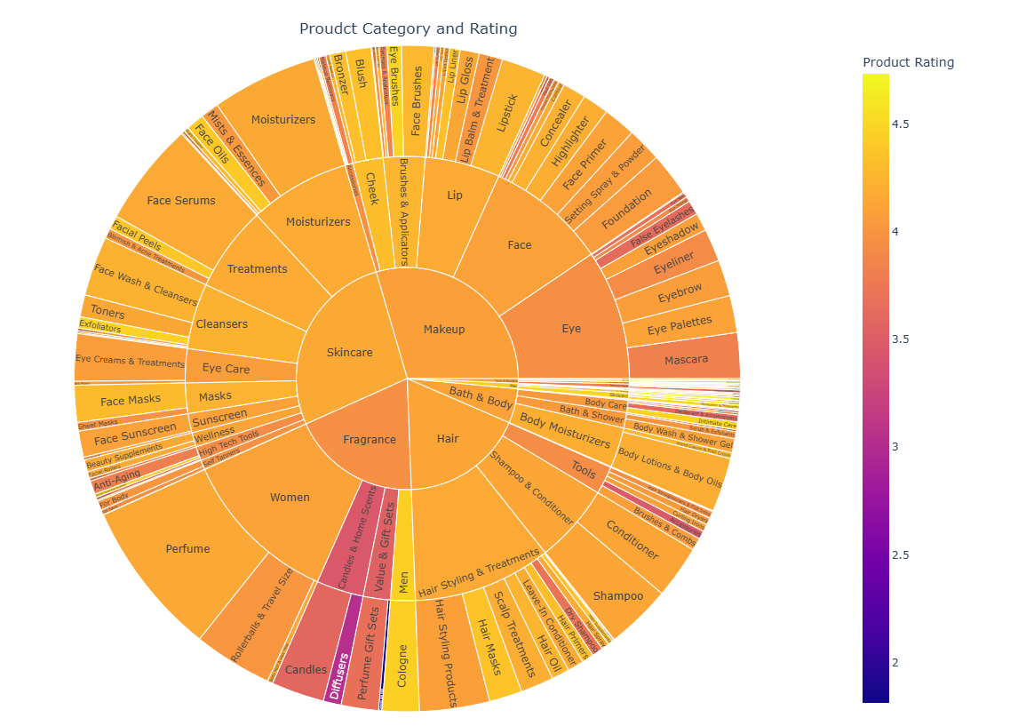
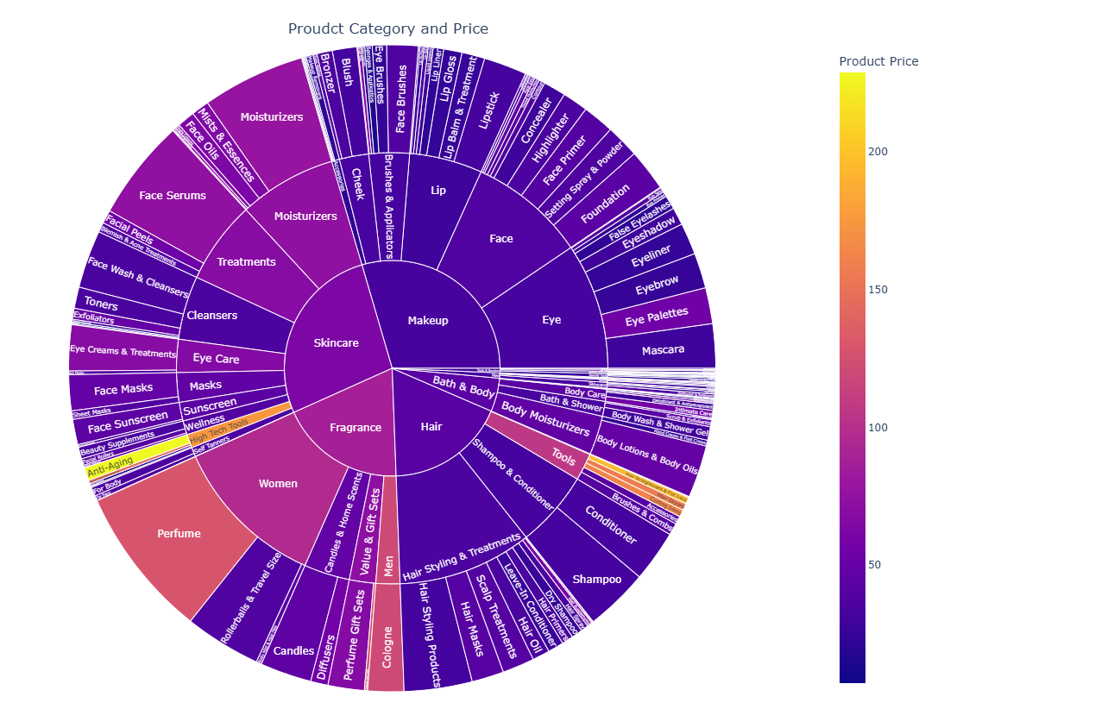
EDA
Notes:
For the EDA, we find that the review dataset is quite sparse, it has too many missing values in the feature columns, the most useful ones are the text and star ratings.
So we are performing EDA mainly on the product dataset to better know our data and explore any potential relation. As for the reviews, we perform the n-gram analysis to understand the text.
These two sunburst plots are based on the product dataset, presenting the categorical variable: product category, against the numerical variable: product rating and price respectively.
First, looking at Ratings on the left, the color represents satisfaction, lighter is better. You can clearly see that Skincare dominates in bright yellow, serving as the high-quality category of Sephora. In contrast, Fragrance and Makeup show much darker colors, This shows while these categories have huge volume, customers are significantly harder to please and give lower ratings.
Next, looking at Price on the right, here yellow means expensive. Notice that the massive Makeup section is deep purple. It acts as the accessible, low-price entry point for customers. Conversely, there is a thin, bright yellow slice for 'High-Tech Tools’ and its sub-category anti-aging. This represents the premium price ceiling of Sephora’s products.

Slide 4
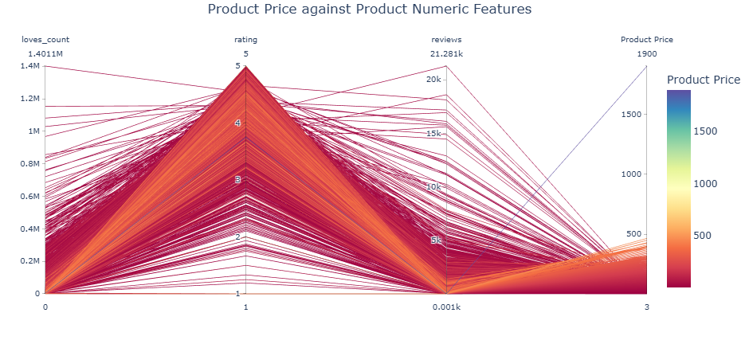
EDA
Notes:
And for this Parallel Coordinates Plot, we use all the numerical variables available to explore their relation, the color represents Product Price, Blue is expensive, and Red is affordable.
There is a very clear trade-off here. Look at the single Blue line on the right. It hits the price ceiling, but it completely drops to zero for 'reviews' and 'loves count’ of the product.
By contrast, look at the massive Red lines, They represent the cheaper products, and they dominate the top peaks of ‘loves count’, ‘rating’ and ‘reviews’, so we can conclude that the accessible, lower price tier product is more likely to go viral.

Slide 5
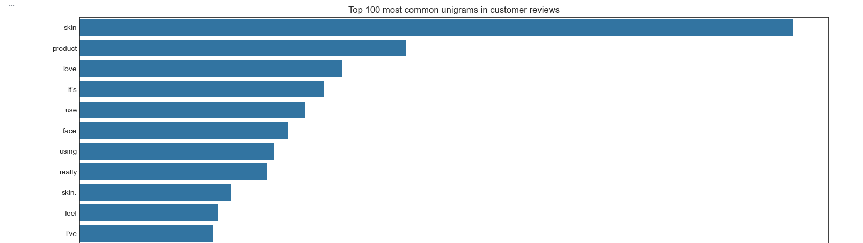
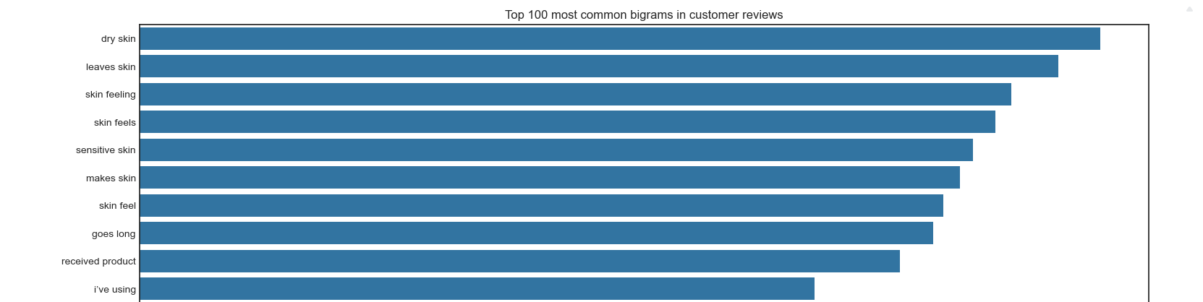
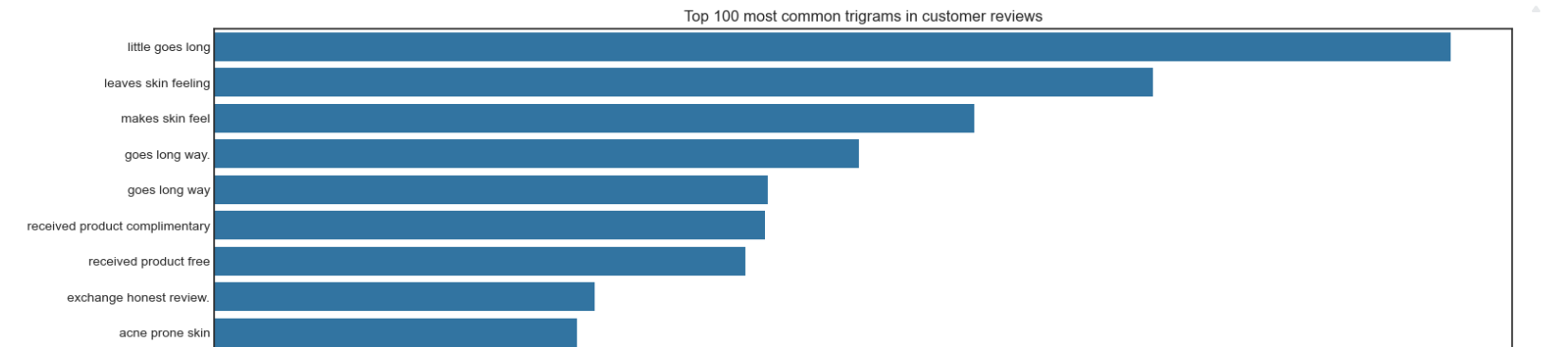
Notes:
And here are the partial, top unigram, bigram, and trigram bar plots. The idea here is to summarize most frequent phrases in customer reviews,
we found that Bigrams, the middle chart, were the most useful. Phrases like 'dry skin' or 'sensitive skin' capture much more meaning than single words.
And from these plots we also notice the punctuation marks sticking to some words in the charts, this alerts us that we need to clean our text before clustering.

Slide 6
Text Cleaning Pipeline
Language Detection
Non – ASCII Character
Substitute unicode punctuation to ASCII version, e.g. ‘ → ‘
Keep Emoji
Lowercase
contraction : e.g. i’ve, it’ll, whould’ve, …
slang/internet slang: u, ur, lol, bc, … title abbreviation: mr., dr., … measurement unit abbreviation: yr, oz, min, ft, …
Abbreviation
URL
Letter Repeat
e.g. soooooo → so, waaay → waay, ….
Punctuation
Random Word
e.g. feskfnrjkgnr …
Notes:
Next is our text cleaning process, we will keep this brief.
The first step is to detect non-English reviews and remove them, then we remove the non-ASCII characters, but here we keep one type of the non-ASCII character, that is the emoji, because our later embedding model understands emoji, so keeping them is helpful to make the sentence embeddings more precise.
our embedding model is context-aware and can understand the emojis, so keeping emoji is helpful for converting precise sentence embedding.
And then we remove the urls, fix words with abnormal repeated letters, and then remove all the punctuation marks, and finally remove unmeaningful random words.

Slide 7
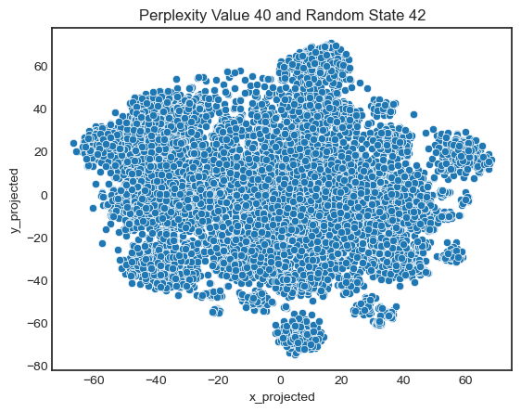
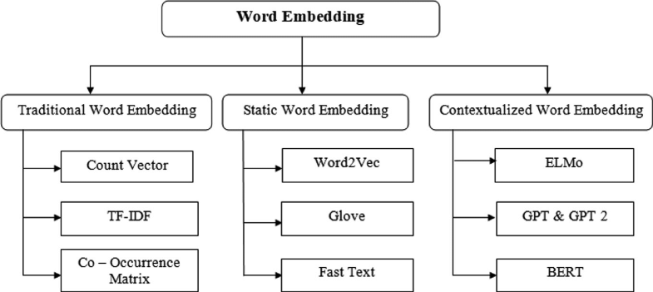
Word Embedding & TSNE
Embedding model: Sentence-BERT
TSNE
Notes:
After cleaning, we input our cleaned texts into a pre-trained SBERT model, the detail of how the BERT model works is skipped,
in general, the BERT family is stronger than the traditional and static word embedding models in terms of handling the modern, complex texts, due to its bi-directional characteristic, what we are doing is to convert each cleaned customer review to a vector, with 384 dimensions, but this dimension is still too high for the computationally intensive algorithms like t-sne,
so we further apply pca to reduce the dimension to 147, which captures 90% total variance of the original data to speed up our computation.
On the right, is the representative t-sne result, it shows a larger main cluster with some small clusters that are not too well-separated, my guess for this is that
because this is a realistic dataset, for the similar topics, people use similar words to describe them, so bert puts them very close together, there isn’t very natural, clear gap between these reviews.

Slide 8
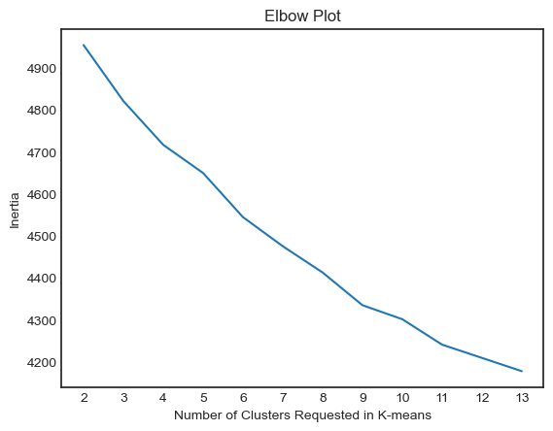
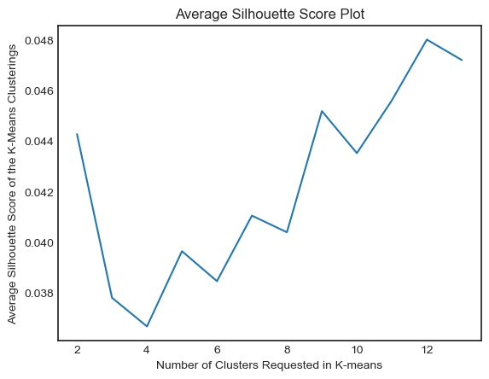
K-Means
Notes:
Our first algorithm is K-Means. We chose it because it is the most computationally efficient option for our dataset size.
The elbow did not show a strong elbow, the possible optimal cluster number we interpret are 6 and 9, the Silhouette Score on the right shows the global peak is at 12.

Slide 9
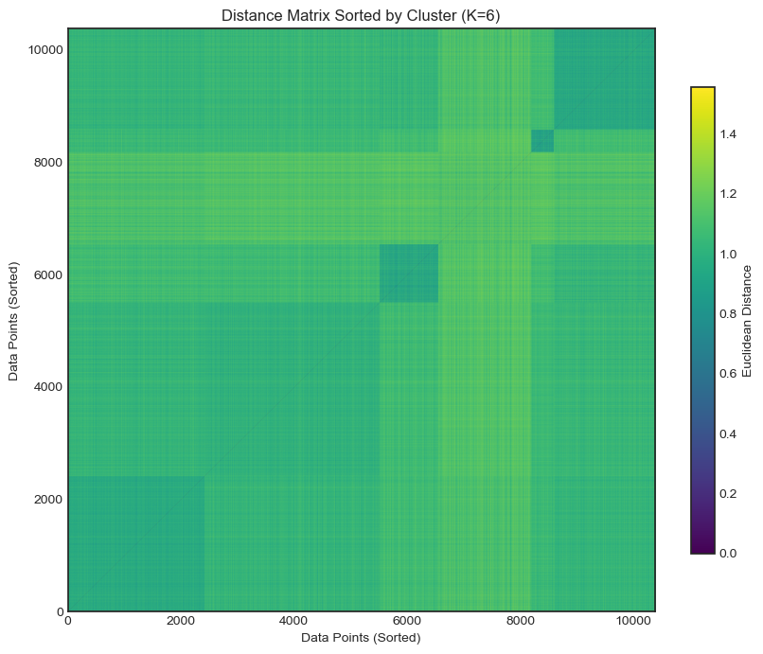
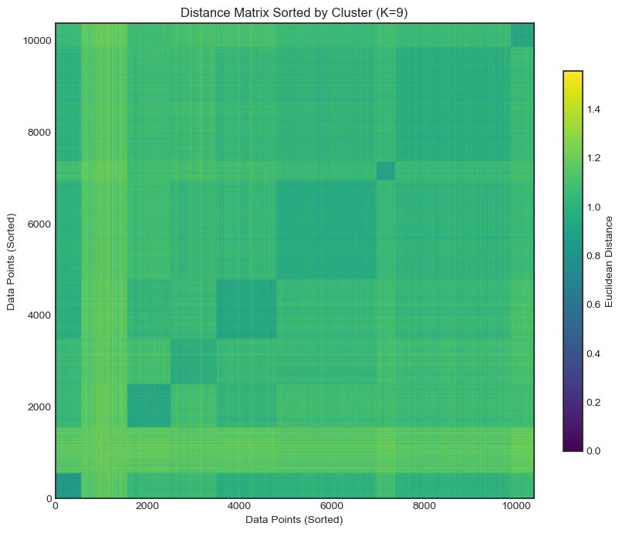
K-Means
Notes:
For the cluster sort matrixs, we created the plots from cluster number of 2 to 13, and can only present part of them here.
The main conclusion from here is that increasing k improves the block-diagonal structure up to a point. However, going beyond this point causes mixing clusters again.
So by combining above the clustering metrics, we select 9 clusters as our optimal cluster number.

Slide 10
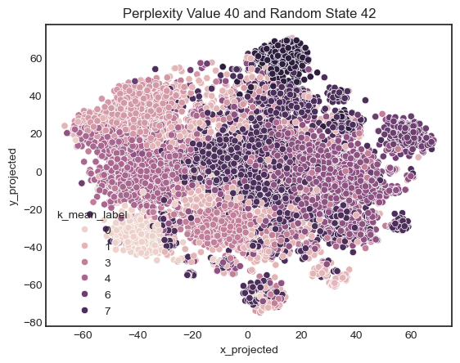
K-Means
Notes:
And here is the result of t-sne, color coded by the predicted cluster labels.

Slide 11
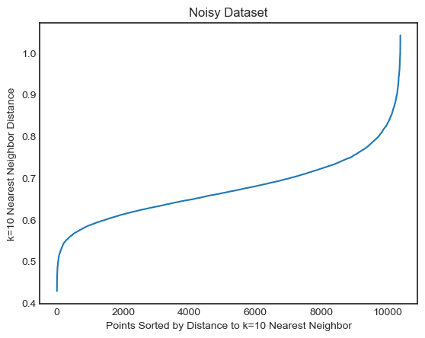
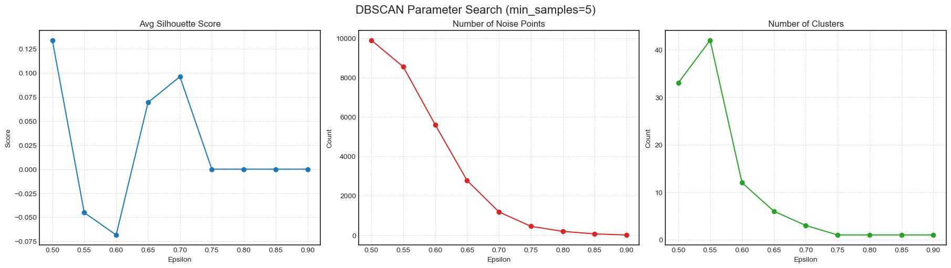
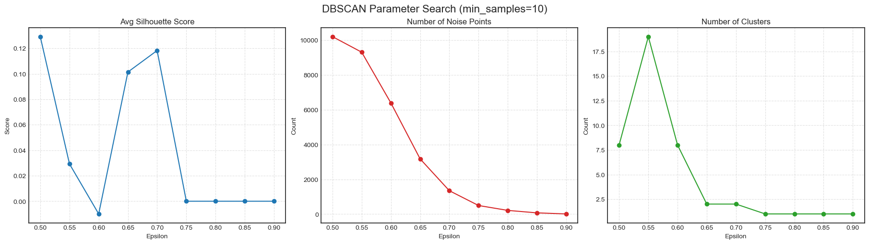
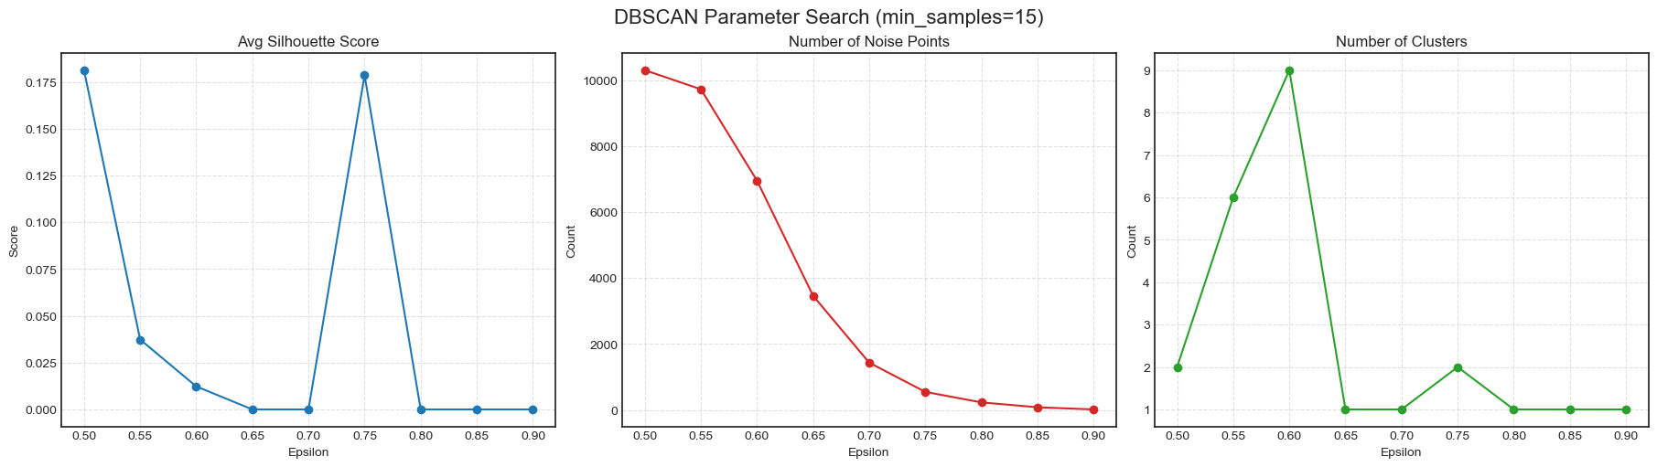
DBSCAN
Notes:
The second algorithm is DBSCAN, since we are expecting the review dataset contains a lot of noise, and also the consideration of our computation limit, so DBSCAN might be a valid choice to detect them.
We first draw the k-neighbor distance plots from k = 2 to 10, and found that k=10 showed the most distinct elbow, and based on that, we defined our parameter range to conduct the parameter tuning
And our final parameter choice is epsilon = 0.65, minimal point number = 5

Slide 12
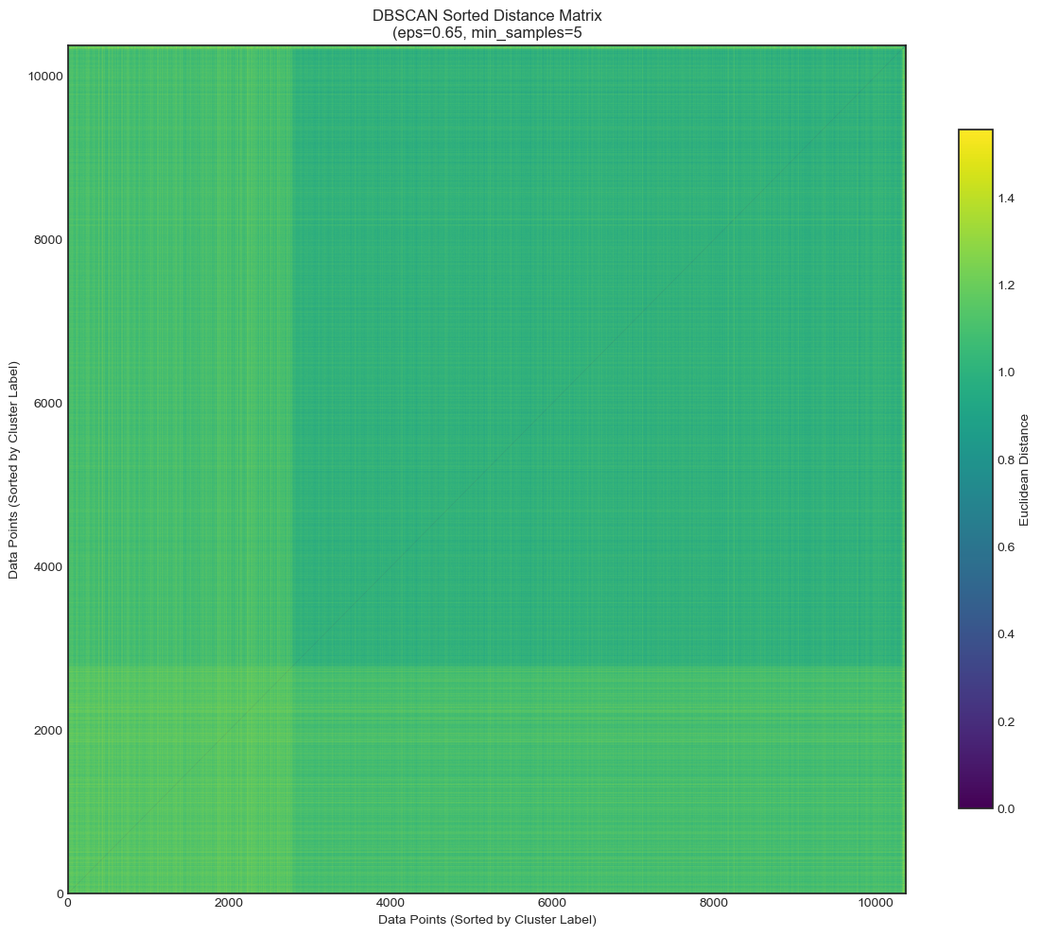
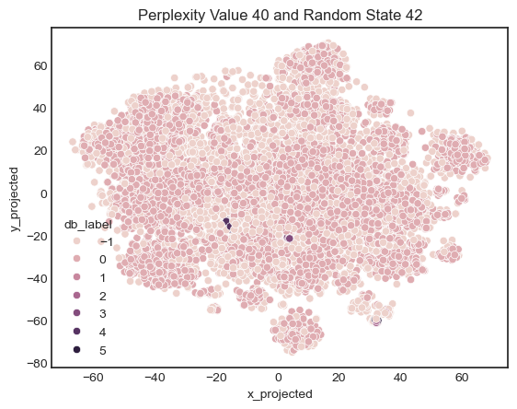
DBSCAN
Notes:
These are the results of the tuned DBSCAN clustering, compared to the results of k-means, k-means clearly shows a more reasonable clustering result across all the metrics we used. So our final clustering result will be using k-means with cluster number set to 9.

Slide 13
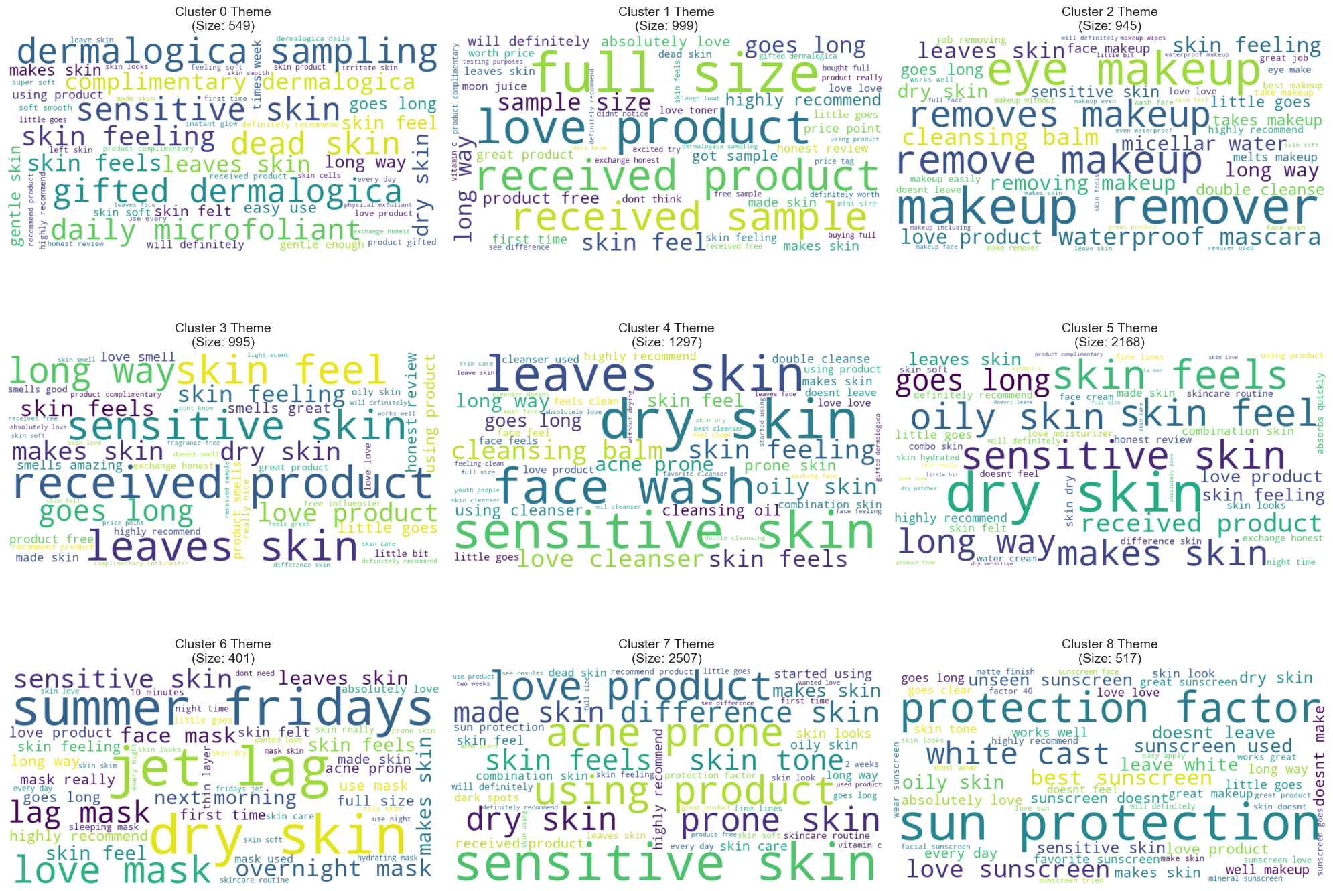
Clustering Result
Notes:
Finally, this is main clustering result visual using word cloud, they represent the top most common bigrams. These clusters can be grouped to 3 categories:
First is about the skin, Clusters 4, 5, and 7 focus heavily on 'acne', 'sensitive', and 'dry skin’.
Second is about the Product, the clustering identified specific lines, the cluster 8 is mainly about Sunscreen, highlighting a critical defect, white cast. Meanwhile cluster 6 captures a viral trend, dominated entirely by the 'Summer Fridays Jet Lag Mask’.
Third one could be Noise, they are almost about non-product feedback.
And finally, some quick notes on limitations of this project:
This is a shallow attempt to cluster, the results are definitely not the most accurate
And The SBERT model is heavy, which limited us to a sample size of 10,000 reviews rather than the full dataset.
Model Assumptions: K-Means assumes clusters are spherical. Since language is continuous and fluid, the model might occasionally split a single, long-tail topic into two separate groups.

Slide 14
Thank you for your attention!

